Slide 1
INDOPACOM Mission Network
UNCLASSIFIED
13 May 2024
UNCLASSIFIED

Slide 2
INDOPACOM Mission Network (IMN)
Vision: USINDOPACOM is fielding a Data-Centric Coalition network to enable agile and secure partnering during all phases of conflict. This Information Domain is designed with native zero trust architecture (NZTA) principals, capable of hosting current Command & Control (C2) & mission applications, while federating directly with mission partners and enterprise level mission partner environment.
FY24 Objectives:
Conduct NSA Blue and Red Team assessment OCT 23 (Completed)
INDOPACOM Mission Network IOC OCT 23 (Completed)
Enable multilateral coalition operations in support of KEEN EDGE 24 (Completed)
ISRMC/DSAWG approval in FEB 24 (Completed)
Postured to integrate with the Joint Fires Network for Ex Valiant Shield 24
Enable US/JPN/KOR tri-lat collaboration by JUN 24
FY25 and Beyond:
Apply lessons learned to expand ZT physical infrastructure/capacity
Decommission/converge extant US owned REL//Japan enclaves
Migrate INDOPACOM partners to the ZT environment (data-centric; single environment)
UNCLASSIFIED

Slide 3
UNCLASSIFIED
MPE vs IMN… Why IMN?
Ensuring a free anD open indo-pacific
MPE: Collection of networks used to exchange information with Allies & Partners
Historically built for specific missions with pre-defined set of mission partners
Limited interoperability between networks (e.g., CENTRIXS FVEY & CENTRIXS Japan do not exchange information or data)
Cross-domain solutions (CDS) reduce reliability & performance
Potentially vulnerable; lacks advanced security protections
IMN: INDOPACOM Mission Network; uses modern security to enable all USINDOPACOM Allies & Partners to coexist in a single information domain
Leverages Data-Centric Security (DCS) in a native Zero Trust Architecture (ZTA) for dynamic Command & Control (C2) of Coalition Forces
Connect directly to key partner systems and data; reduces the need for CDS
Host modern mission applications; provide continued and secure access to current C2 programs of record
Will eventually preclude the need for existing separate partner networks
GLOBAL MISSION PARTNER ENVIRONMENT
Enables Communication, Collaboration, Planning & Execution with the Right Partner at the Right Time

Slide 4
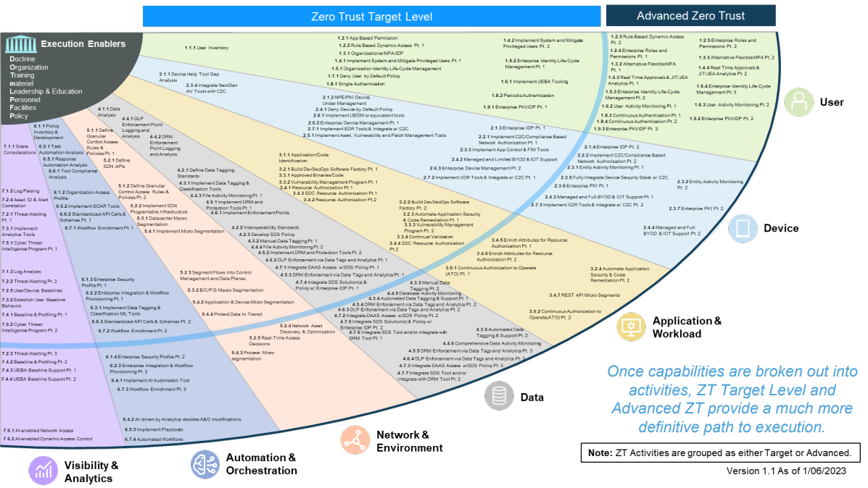
UNCLASSIFIED
Zero Trust (ZT) & Data-Centric Security (DCS)
Ensuring a free anD open indo-pacific
ZT: Evolving set of cybersecurity paradigms that move defenses from static, network-based perimeters to focus on users, assets, and resources.
Assumes no implicit trust is granted to assets or users based solely on their physical or network location or asset ownership
Significant change in legacy authentication and security mechanisms; requires a major cultural change for all of DoD
DCS: Prioritizes the protection of data itself, wherever stored, accessed, or used. Involves identifying sensitive data, classifying appropriately, and implementing security controls and policies to protect it.
Focus on protecting data throughout its lifecycle rather than just securing the perimeter of a network or device
Includes various techniques and technologies, such as access controls, rights management, and data loss prevention tools
Requires all network users to be more “data aware”
DoD has mandated the implementation of ZT for all networks by 2027
UNCLASSIFIED

Slide 5
CL
FY23/24 IMN Fielding POAM
FY23 | FY24 | FY25
1
NSA ZT Review
USFJ CX-J C2 Assessment
4
Assessment
KEEN EDGE COMEX
ISRMC/
DSAWG
VALIANT SHIELD COMEX
2
Blue / Red Team
Blue Team
Remediation
Remediation
Optimization
Remediation
Optimization
Engineering/Integration
Requirements / Design
Application Integration & Deployment
Deployment of ZT Security/Architecture
KEEN EDGE Integration
VALIANT SHIELD Integration
Node Deployed at Hickam
JPN
Connection
Test Instance deployed
KOR
Connection
CENTRIXS Maritime
Connection
Hardware Deployment
Nodes Deployed at Yokota AB, JP & Cp Humphreys, ROK
Node Deployed in Guam
Mobility Gateway
FVEY
Connection
Mobility Gateway
Mobility Gateway
Exercise
3
5
6
KEEN EDGE
VALIENT SHIELD
ULCHI FREEDOM SHIELD
KEEN SWORD
NSA/DOD Zero Trust Review
External Blue & Red Team Evaluation
KEEN EDGE 24 Execution
DoD Information Security Risk Management Committee (ISRMC) Review
VALIANT SHIELD 24 Execution (FOC)
US/JPN/KOR Tri-lat Collaboration Environment
1
4
2
5
3
6

Slide 6




















IMN
Monitoring Data
DoD ENTERPRISE
Monitoring Data
CYBER SECURITY
SERVICE PROVIDER
(CCSP)
NATIONAL
NETWORKS
USINDOPACOM MPE
INFORMATION DOMAIN
JPN
USER CENTRIXS-JPN
FEDERATION
U.S. IPC CX-JPN
CONNECT
IMN DMZ
Application
Data
KOR
USER CENTRIXS-KOR
FEDERATION
U.S. IPC CX-KOR
CONNECT
REL-DMZ
FEDERATION
U.S. IPC CX-FVEY
CONNECT
User
Access
USER CENTRIXS-CMFP
U.S. IPC CX-CMFP
INDOPACOM
FEDERATION
CONNECT
MISSION NETWORK
CDS
ACCESS CDS
CDS
C2 FEEDS
MULTI-ENCLAVE CLIENT
SIPR
All security domains are accessible through existing MPE MEC Service
MISSION PARTNER USER SITE
U.S. MPE SITE
IMN
AuthN
IMN DMZ
User
Client
Firewall
Router
KG-175
KG-175
Router
Firewall
Router
Firewall
User logs into national network client OS
(Windows) using their national network account
User browses to IMN DMZ Citrix Netscaler URL
and logs in with their IMN Account

Slide 7
UNCLASSIFIED
What IMN really looks like…
UNCLASSIFIED

Slide 8
UNCLASSIFIED
Questions?
UNCLASSIFIED

Slide 9
UNCLASSIFIED
Backup Slides
UNCLASSIFIED

Slide 10
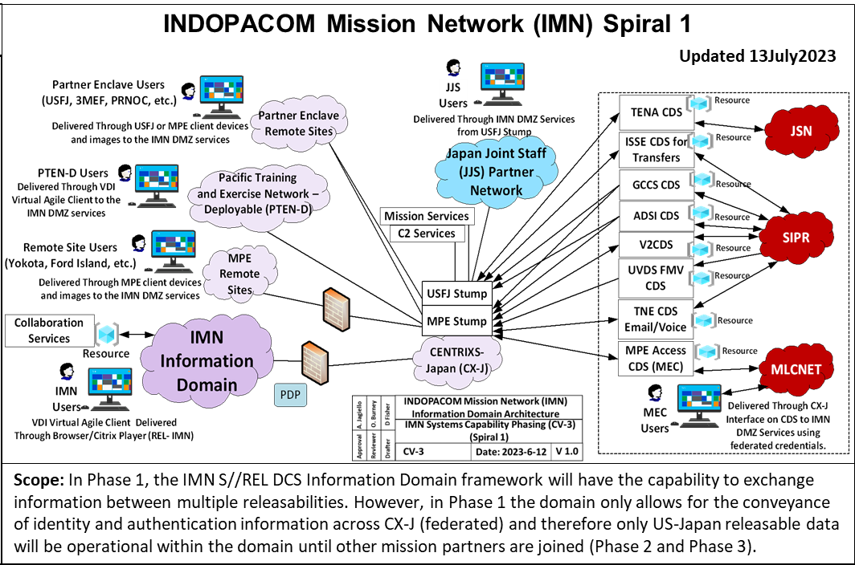
UNCLASSIFIED
IMN Spiral 1
UNCLASSIFIED

